Slide 1

HTML Lists
MORESH LONDE

Slide 2

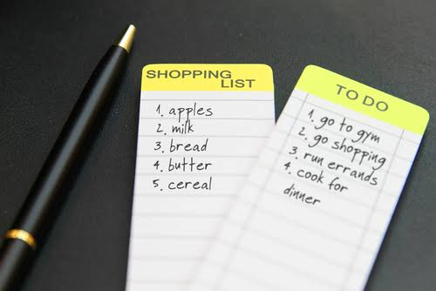
List
Examples
Shopping List
To-Do List
Recipe Ingredients

Slide 3
Types Of Lists
Ordered List
Unordered List
Definition List

Slide 4
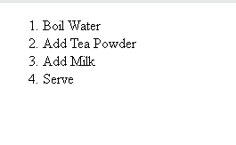
Ordered List
Used when sequence matters.
Tags
<ol> opens and closes the numbered list.
<li> still defines each individual item.
Example
<ol>
<li>Boil Water</li>
<li>Add Tea Powder</li>
<li>Add Milk</li>
<li>Serve</li>
</ol>

Slide 5
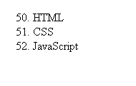
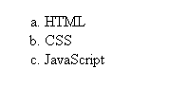
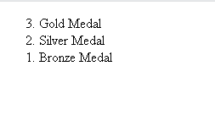
<ol start="50">
<li>HTML</li>
<li>CSS</li>
<li>JavaScript</li>
</ol>
<ol reversed>
<li>Gold Medal</li>
<li>Silver Medal</li>
<li>Bronze Medal</li>
</ol>
<ol type="a">
<li>HTML</li>
<li>CSS</li>
<li>JavaScript</li>
</ol>

Slide 6
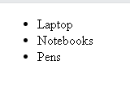
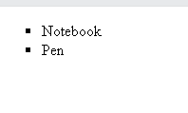
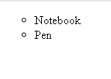
Unordered List
Used when order doesn't matter.
<ul>
<li>Laptop</li>
<li>Notebooks</li>
<li>Pens</li>
</ul>
<ul style="list-style-type:square;">
<li>Notebook</li>
<li>Pen</li>
</ul>
<ul style="list-style-type:Circle;">
<li>Notebook</li>
<li>Pen</li>
</ul>

Slide 7
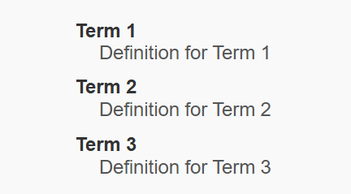
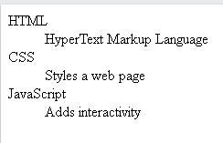
Definition List
A definition list is a list of terms, with a description of each term.
<dl> tag defines the description list,
<dt> tag defines the term (name)
<dd> tag describes each term
<dl>
<dt>HTML</dt>
<dd>HyperText Markup Language</dd>
<dt>CSS</dt>
<dd>Styles a web page</dd>
<dt>JavaScript</dt>
<dd>Adds interactivity</dd>
</dl>

Slide 8
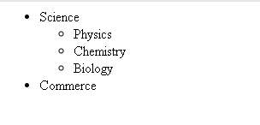
Nested List
List inside another list.
<ul>
<li>Science
<ul>
<li>Physics</li>
<li>Chemistry</li>
<li>Biology</li>
</ul>
</li>
<li>Commerce</li>
</ul>

